Slide 1

Analysis Project
Presented by: Deborah Matthew
Date: December 2025

Slide 2
Table of content
Objective
Data Presentation
Recommendations
Conclusion

Slide 3
Objective
The objective of this analysis is to examine Fitbit smart device usage data to identify trends in user activity, sleep, and overall wellness behaviour.

Slide 4

Data Presentation

Slide 5
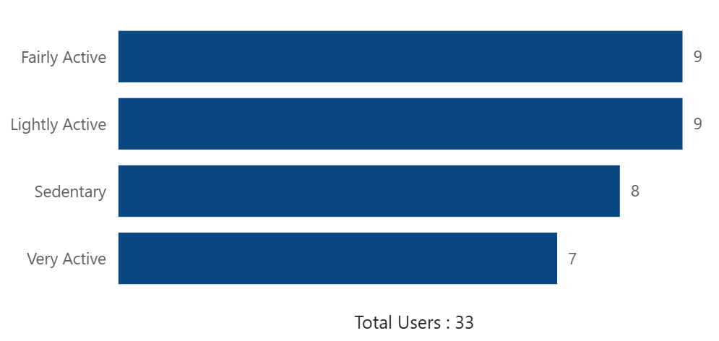
User Activity Categories

Slide 6

User Activity Categories
Most Users are fairly or lightly active
A significant share of users are below recommended activity levels.

Slide 7
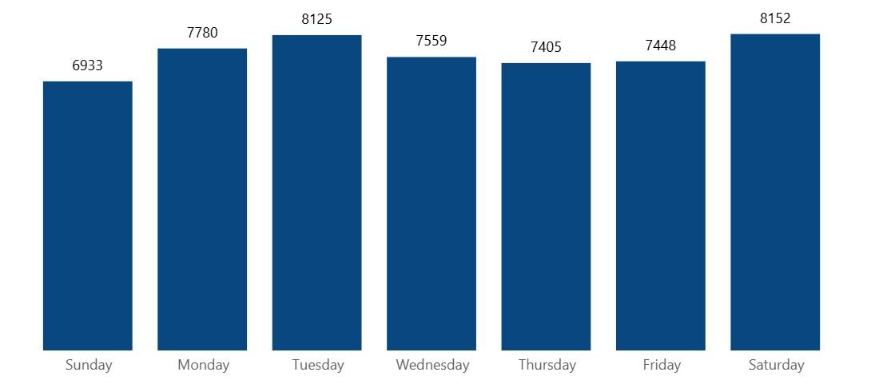
Activity by weekday

Slide 8
Activity by weekday
Activity peaks on Saturday, while lower activity levels occur on some weekdays.
This implies that users are more active either when they have more free time or when daily routines are flexible.

Slide 9
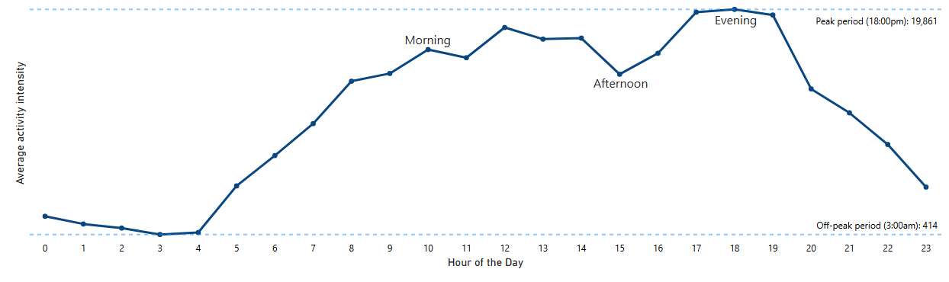
Activity Peak Period

Slide 10
Activity Peak Period
Users follow natural daily routines, which include morning exercise and post-work movement.

Slide 11
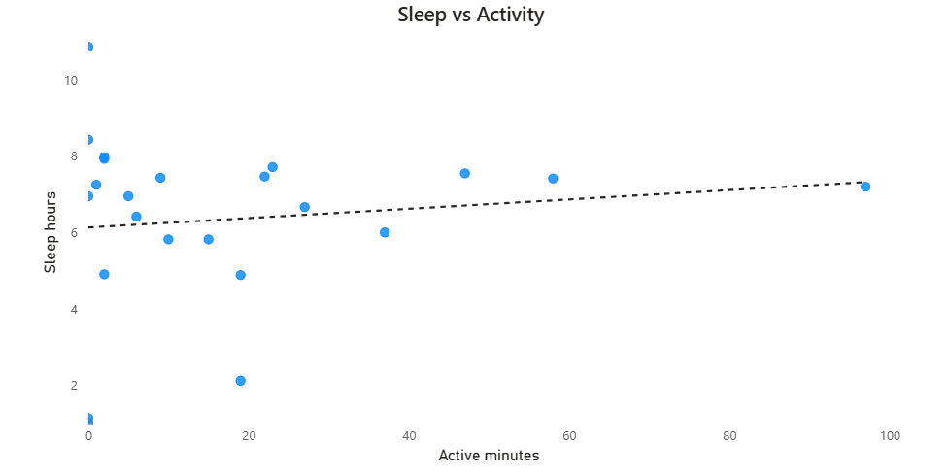
Sleep Vs Activity

Slide 12
Sleep
Sleep Vs Activity
24 users
A weak positive relationship between physical activity and sleep duration.
Physical Activity Has a Limited Impact on Sleep Duration
Activity

Slide 13


Slide 14
Recommendations
1.
2.
3.
4.
Market Bellabeat as a balanced wellness companion, not an intensity-driven fitness tool.
Use time-based marketing campaigns aligned with peak user activity hours
Target lightly and fairly active users with achievable, habit-forming wellness messaging.
Personalize marketing content and in-app messaging using activity insights

Slide 15


Slide 16
Conclusion
This analysis demonstrates that smart device data provides valuable insights into user engagement with health and wellness tracking. While users tend to follow predictable activity patterns, peaking on Saturdays and during morning or early evening hours, most do not consistently reach high activity thresholds.
Additionally, physical activity alone does not strongly influence sleep duration, highlighting the importance of a balanced approach to wellness.

Slide 17
THANK YOU!

